Slide 1


Global Settlement Classification from True-Color Satellite Imagery
Vincent Zhang
33rd International Conference on Geoinformatics
University of Virginia — School of Data Science
July 21, 2026

Slide 2
Problem Definition
The goal of this research project is to:
  classify any true-color image taken by a satellite of Earth into one of three categories:
    an urban settlement
    a rural settlement
    uninhabited land
  The definitions of each of these categories are derived from the publication by Liu et al. (2024).
  As land-cover heterogeneity cannot be discretized without excessive information loss, the final predictions are soft probabilities that sum to 1.

Slide 3
Data Collection
We want to obtain true-color satellite imagery from a reputable source.
  That means any generated simulations of satellite data (such as fake layers) are prohibited.
Microsoft's Planetary Computer gives us datasets from Harmonized Landsat and Sentinel-2 (HLS) v2.0 at 30-meter resolution.
  The coverage of the world is extensive, and this will be the dataset of choice.
The ground truths will be determined by the 2020 Global Rural and Urban Settlement (GURS) dataset (Liu et al., 2024).
  A value of “1” represents urban.
  A value of “2” represents rural.
  A value of “127” represents uninhabited.

Slide 4
Region Selection
To ensure equal coverage of most human settlements in the world, we select six bounding boxes, each representing a geographical area of human activity for every inhabited continent.
  Europe and Asia will be considered separate continents since analysis is done on human and not natural geography.
For each continent, the following regions are cut off due to low population density:
  North America: most of northern Canadian territories and all of Alaska
  Asia: much of the Siberian wilderness and Eurasian Steppe
  South America: most of Patagonia
  Africa: most of the Sahara desert
  Australia's outback will be kept to see how the model performs.
  Edge cases, such as ocean data and Antarctica, may appear sporadically but are not the focus of the model.

Slide 5
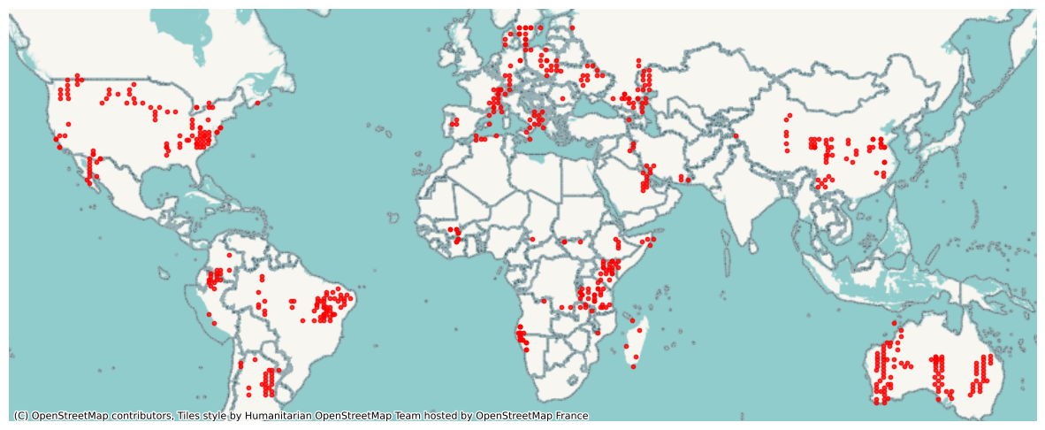
Satellite Imagery Coverage

Slide 6
Satellite Imagery Preprocessing
The raw GeoTIFFs all have different coordinate reference systems, but GURS uses WGS 84.
  Therefore, we convert all the imagery to EPSG:4326.
Furthermore, to help the model digest the imagery more easily, we need to avoid loading whole GeoTIFFs into RAM at a time.
  For any raw GeoTIFF, we can slice the raster into 64 quadrants to enhance surface detail.
Some tiles will be mostly black.
  If more than 20% of the tile is black pixels, we discard it. Otherwise, we save the output into a new directory on disk.
This process generates 30,444 distinct satellite tiles.

Slide 7
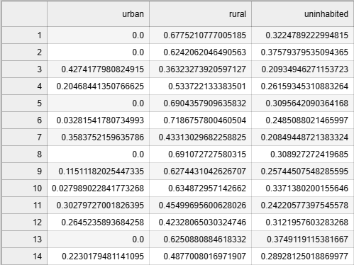
Ground Truth Preprocessing
The ground truths of each tile will be extracted from the GURS 2020 raster in two main steps:
  Isolate the portion of GURS 2020 such that it represents the geographical area covered by any specific tile.
  Assign a score to each land-cover label in the GURS dataset (urban, rural, uninhabited), reflecting the fractional representation of the respective class within each region.
Finally, the frequencies are saved as a CSV file representing the ground truths of each tile.

Slide 8
Unsupervised Learning
k-means clustering was chosen as the unsupervised learning technique.
We select 19 distinct features to easily cluster the data based on certain visual aspects of the tile.
  For example, urban tiles are noisier due to the number of structures. Uninhabited deserts should look smooth and homogeneous.
  The features are the mean, standard deviation, 10th, 50th, 90th percentiles of each RGB band, as well as some other statistics related to noise and variance of each patch.

Slide 9
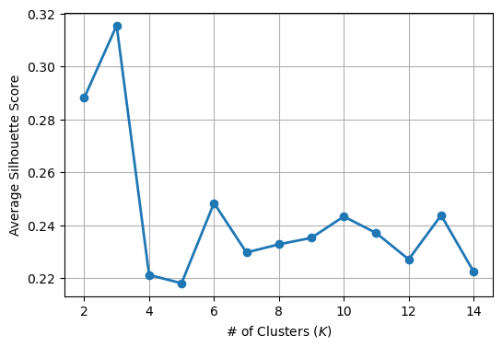
Mean Silhouette Score vs. k

Slide 10
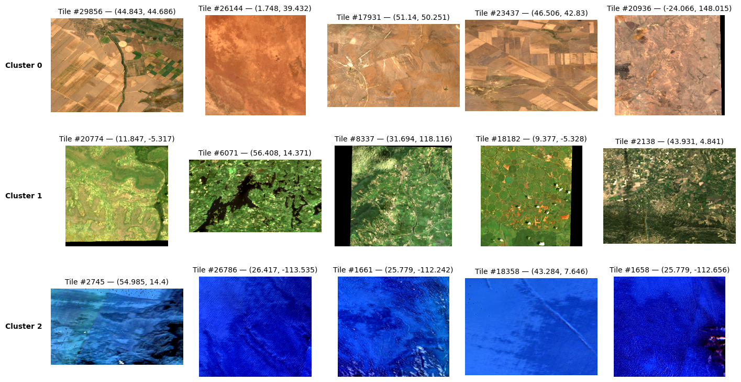
Selected Tiles for k = 3 Clusters

Slide 11
Shallow Supervised Learning
The first supervised learning technique chosen was gradient boosting.
  For each tile, we extract 12 features containing the mean, standard deviation, minimum, and maximum of each RGB band.
  Due to extreme class imbalance, we also want to oversample minority classes during the training phase. (This will be true for all supervised learning models.)
After performing a 7-fold cross validation on a grid of 432 candidates, the best hyperparameters are:
  η = 0.01, α = 0, λ = 1, max(depth) = 8
  n_estimators = 800, colsample_bytree = 0.8, subsample = 0.8
Best cross-validated log loss: 0.142

Slide 12
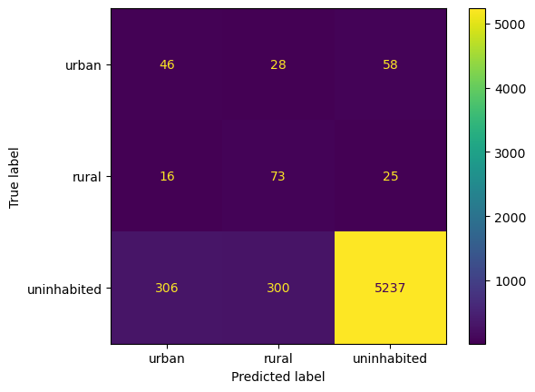
Gradient Boosting Evaluation
Evaluation is done on an 80% to 20% train-test split.
Selected metrics:
  Cross Entropy = 0.2932
  Accuracy = 0.8796
  Macro Precision = 0.4305
  Macro Recall = 0.6284
  Macro F1 Score = 0.4686

Slide 13
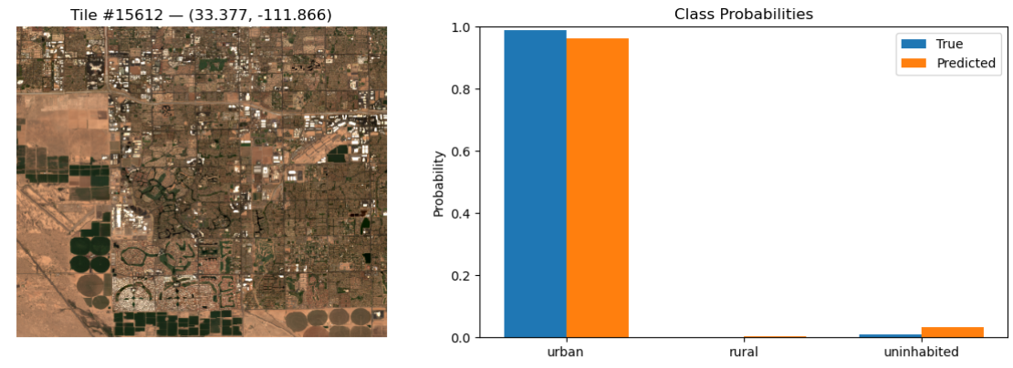
Gradient Boosting Top Predictions - Urban
Phoenix, Arizona, U.S. (https://maps.app.goo.gl/bt2JWSW8afXVU9fX7)

Slide 14
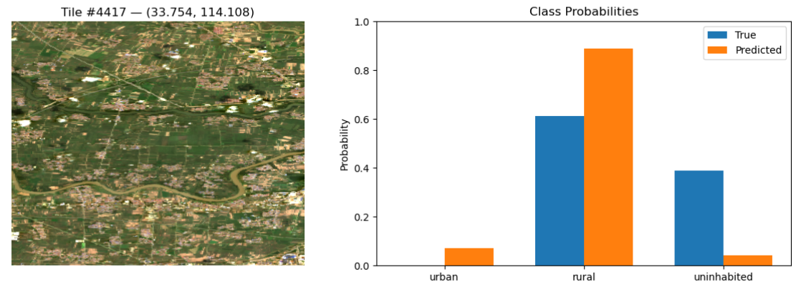
Gradient Boosting Top Predictions - Rural
Linying County, Luohe, Henan, China (https://maps.app.goo.gl/wnEjTqggmo27DeJr5)

Slide 15
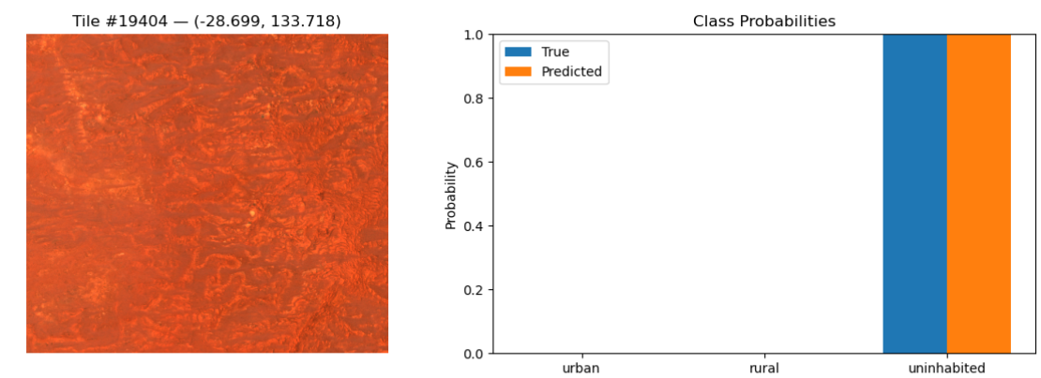
Gradient Boosting Top Predictions - Uninhabited
Tallaringa Conservation Park, South Australia (https://maps.app.goo.gl/ZJA3veYzmqNFn3Vs7)

Slide 16
Deep Supervised Learning
The second supervised learning technique chosen was using convolutional neural networks.
  Due to hardware constraints and the nature of the problem, ResNet-34 was chosen to be the CNN we will tune.
He et al. (2015) stated that this type of residual network with 34 parameter layers has around 3.6 GFLOPS. Given the theoretical peak of our GPU (~4.4 TFLOPS), we can do well over a thousand forward passes per second.
  Even though real training will be much slower, this still gives us enough headroom to not suffer too much of a slowdown given our GPU.
After performing a 5-fold cross validation on a grid of 18 candidates with 3 epochs each, the best hyperparameters are: η = 10⁻⁴, λ = 10⁻⁵, p = 0.2
  Lowest validation loss = 0.3195

Slide 17
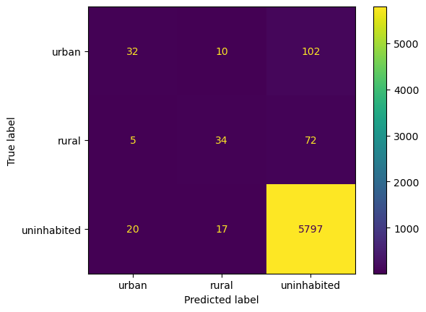
ResNet-34 CNN Evaluation
Once again, evaluation is done on an 80%/20% train-test split.
  The final model was trained over 30 epochs. (10x epochs of grid search)
Selected metrics:
  Final average validation loss = 0.3172
  Accuracy = 0.9629
  Macro Precision = 0.6965
  Macro Recall = 0.5074
  Macro F1 = 0.5653

Slide 18
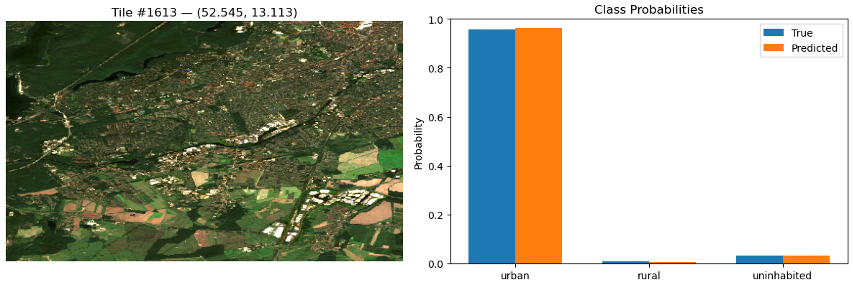
ResNet-34 CNN Top Predictions - Urban
Western Berlin, Germany (https://maps.app.goo.gl/pisL3rcDGvqDbPZm8)

Slide 19
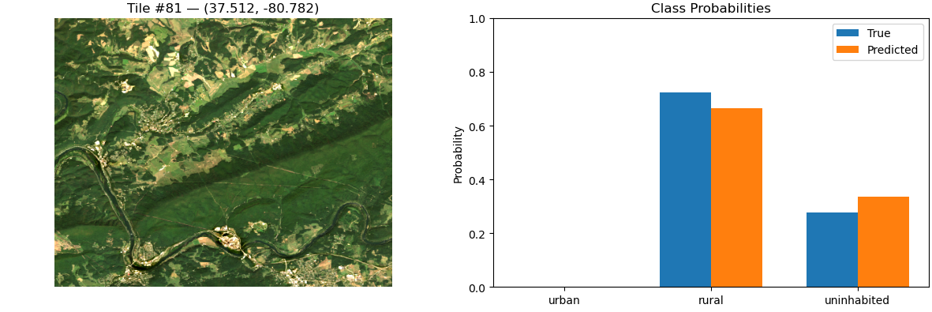
ResNet-34 CNN Top Predictions - Rural
Peterstown, WV, U.S. (https://maps.app.goo.gl/wA58TmNsWdNdjtct9)

Slide 20
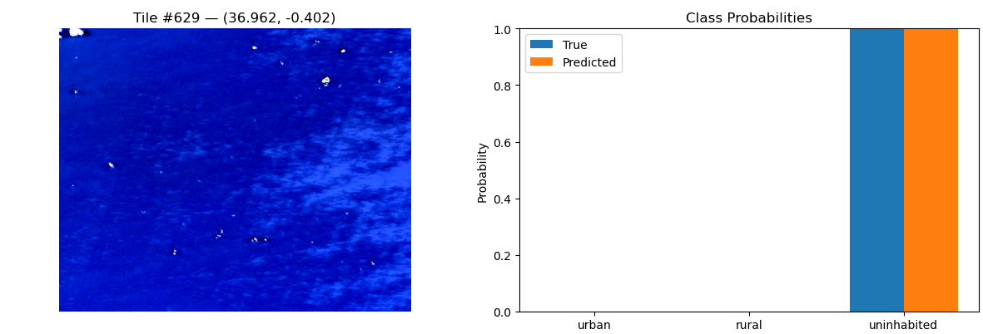
ResNet-34 CNN Top Predictions - Uninhabited
Alboran Sea (https://maps.app.goo.gl/akkkrvEkJTL13TVT9)

Slide 21
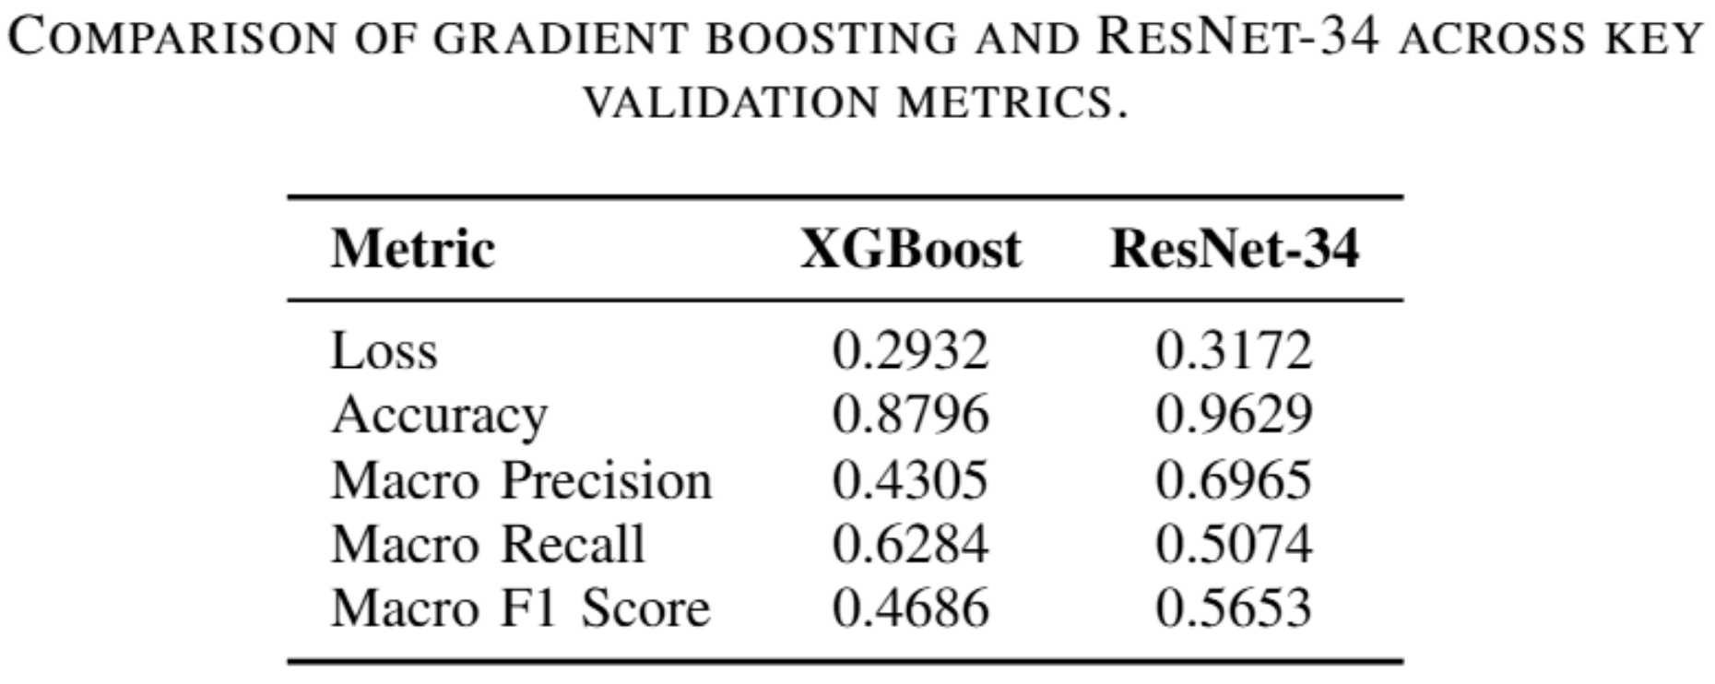
Supervised Model Metrics Comparison

Slide 22
Conclusion
For unsupervised learning, k-means clustering surprisingly clustered more on color than noise.
  This produced three distinct clusters representing green forestry/grassland, deserts, and bodies of water.
For supervised learning methods, gradient boosting and CNNs performed much closer than expectation.
  Looking at the qualitative top predictions of satellite photographs, gradient boosting made much more intuitive predictions (due to higher recall) than the ResNet-34 model.
  However, the metrics indicate that ResNet-34 outperformed gradient boosting in both accuracy, macro precision and F1 score.
Although ResNet-34 has more higher metrics than gradient boosting, the extreme class imbalance of the dataset makes recall critical.
  Misclassifying a minority class (urban/rural) as uninhabited leads to loss of important human-settlement information.
  In many remote sensing domains, missing urban/rural tiles is worse than misclassifying a few uninhabited tiles.
Therefore, the recommendation is to use gradient boosting considering the problem domain, metrics, and training efficiency when it comes to large-scale satellite settlement tile classification.

